Slide 1
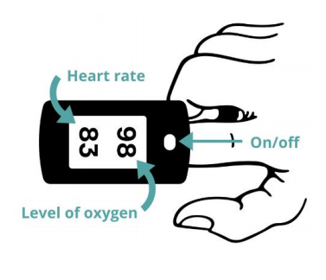
Pulse oximetry@home - Wed 13 Jan 2021
The presentation will start shortly…..
Meeting etiquette
Please put yourself on mute
Allow the presenters to go through their talk
Do make use of the Meeting Chat to make comments and ask questions – these will be picked up either at the end of the webinar or in the ‘FAQ’ document
Follow up
We will be recording the event – and sharing the presentation afterwards
Do email us for further information if you have subsequent comments (email addresses at end of presentation)
If there are any further updates they will sent through the covid bulletin

Slide 2
Pulse oximetry@home
GP webinar Wednesday 13th Jan 2021 12.30-1.15pm
Dr Bruce Willoughby
Sam Haward
Julie McGregor

Slide 3
Objectives
By the end of the session you will :
Understand the national context of pulse oximetry@home
Understand the local pathway and resources available
Be confident to set up and use pulse oximetry@home
Know how to easily record the right minimum data for evaluation

Slide 4
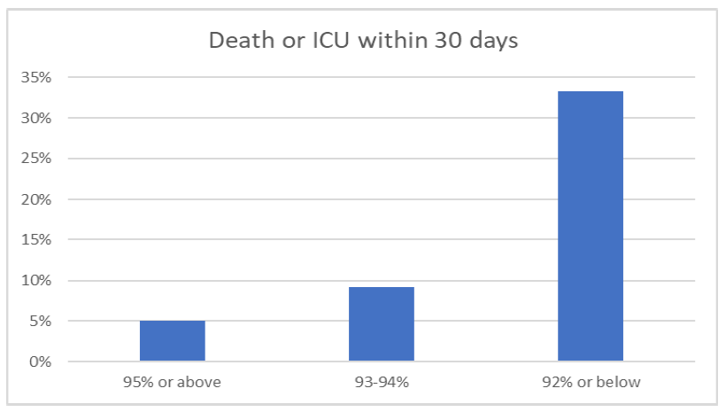
Background
Monitoring COVID positive patients in their own homes and Care Homes with pulse oximeters this winter
Reduce COVID mortality by early recognition of hypoxia
Reduce pressure on hospital capacity
Based on successful national pilots, e.g. Tees Valley
1800 pulse oximeters ordered for NY (for GP practices, Care Homes)
Step-up clinical model developed with PCNs, Federations and LMC
Care Home protocol developed in parallel
Funding included in new £150 million allocation
Part of revised NHS England GP SOP

Slide 5
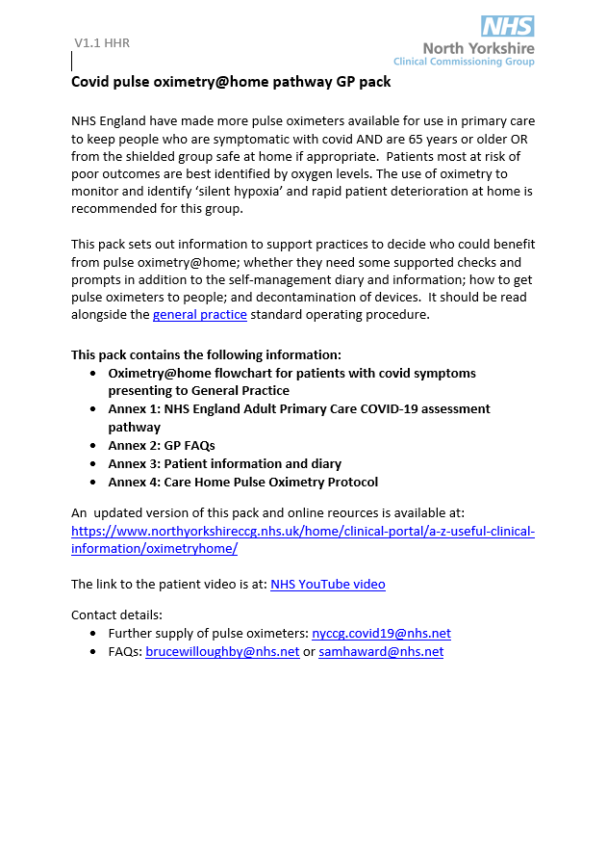
GP pack
Pathway
Clinical pathway
GP FAQs
Patient Information and diary
Care Home pulse oximetry protocol

Slide 6
NYCCG website
www.northyorkshireccg.nhs.uk/home/clinical-portal/a-z-useful-clinical-%20information/oximetryhome/

Slide 7
NYCCG website
www.northyorkshireccg.nhs.uk/home/clinical-portal/a-z-useful-clinical-%20information/oximetryhome/

Slide 8
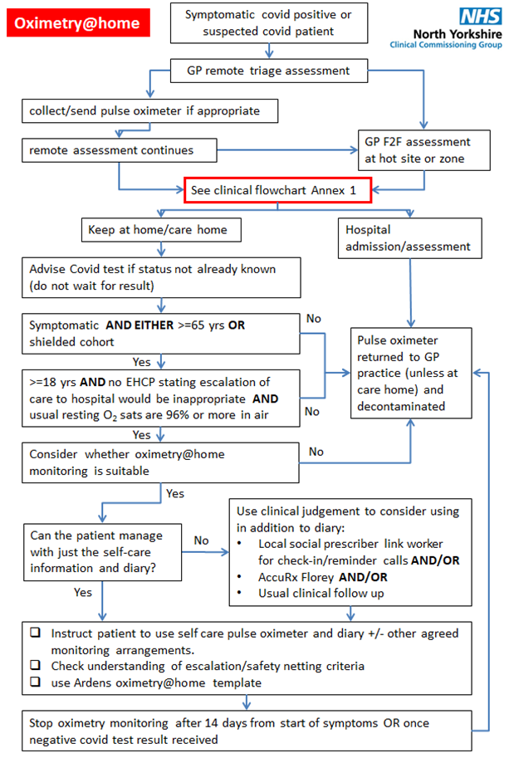

Slide 9
Assessment
Collection of oximeters
Family member/friend
Goodsam app (goodsamapp.org/NHSreferral or 0808 196 3382)
NYCC customer care (01609 780780)
Hot sites
Care Homes
Training given
GP decision

Slide 10
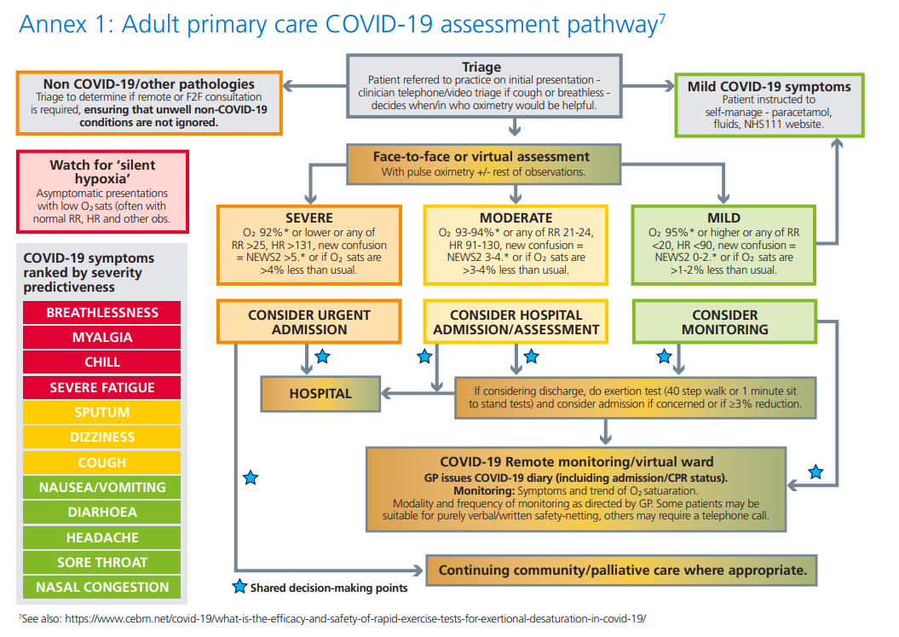
Clinical Pathway

Slide 11
Entry criteria
Symptomatic AND EITHER
>=65 yrs OR
Shielded (..or concern)
Excluded
<18 years old OR
EHCP hospital admission not appropriate
Usual O2 sats <=95%

Slide 12
Types of monitoring
Self monitoring +/-
Check in reminders
AccuRx
Usual clinical follow up

Slide 13
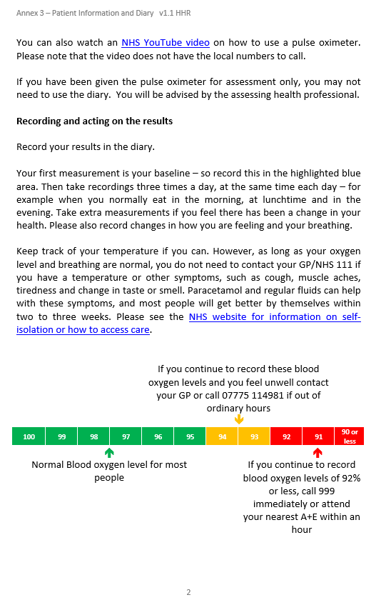
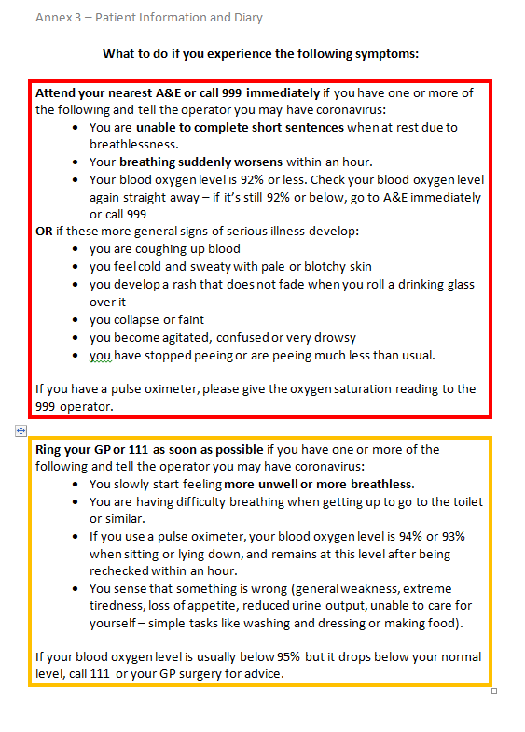
Patient leaflet

Slide 14
Patient video
www.youtube.com/watch?v=ifnYjD4IKus

Slide 15
Patient diary

Slide 16
Check-in reminders
?use social prescribing link workers
Arrange which days calls will be made and which number to call (usually days 2, 5, 7, 10 and 12)
Welfare check
?Using oximeter correctly
Parameters to escalate for clinical review

Slide 17
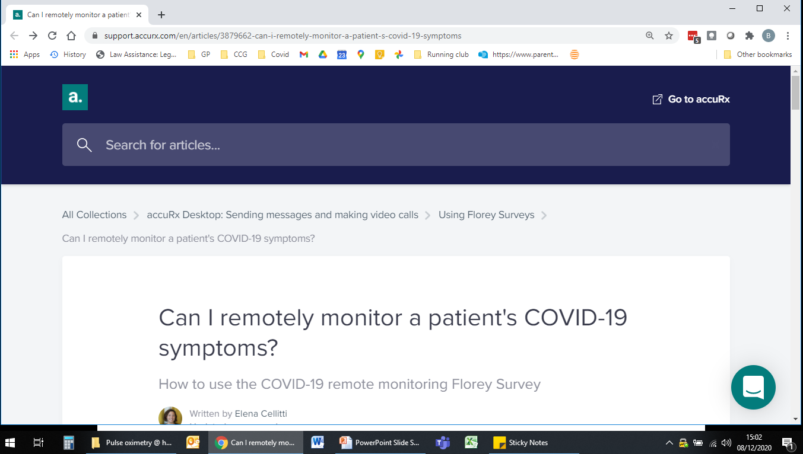
AccuRx
https://support.accurx.com/en/articles/3879662-can-i-remotely-monitor-a-patient-s-covid-19-symptoms

Slide 18
111 or Out of Hours direct?
The video and some other national materials reference ringing 111 out of hours if sats are 93-94%
Regionally, 111 have requested that all OOH requests for help are signposted to the local OOH provider directly
Two versions of the local resources have been produced by OOH provider based on patient’s registered GP
Hambleton, Richmondshire and Harrogate (HDFT OOH) and
Scarborough, Whitby and Ryedale (Vocare OOH)
Each have specific direct lines only to be used for oximetry@home patients – and only for queries relating to their oximetry readings
Adding special notes via Adastra is helpful
Patients need to be counselled to use these numbers
111 continues to be accessible to all

Slide 19
Safety netting and template

Slide 20
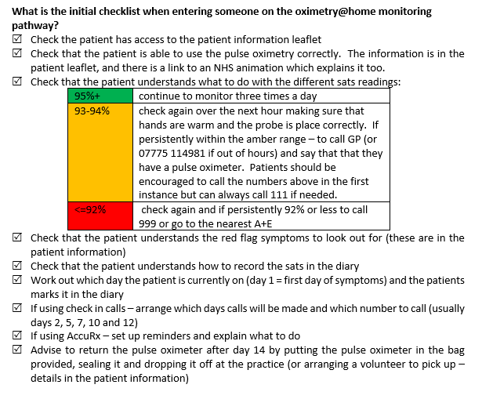
Checklists

Slide 21
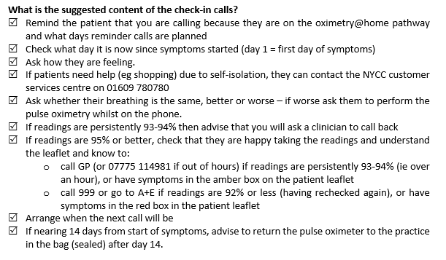
Checklists

Slide 22
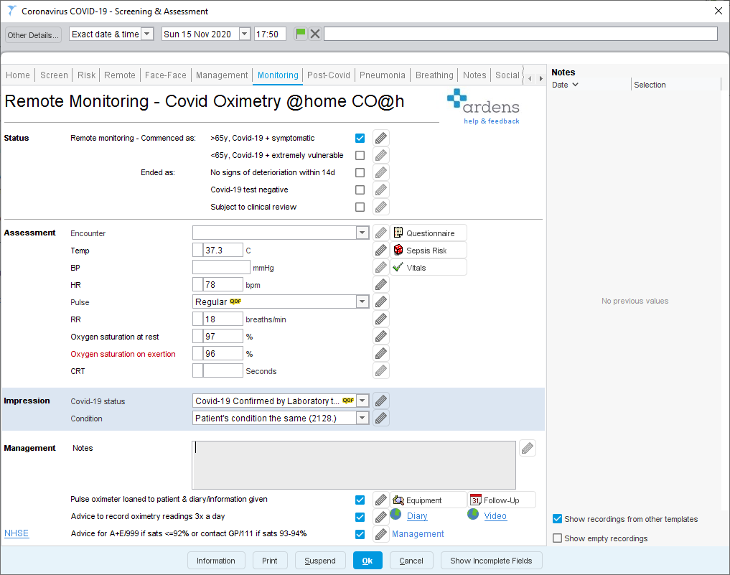
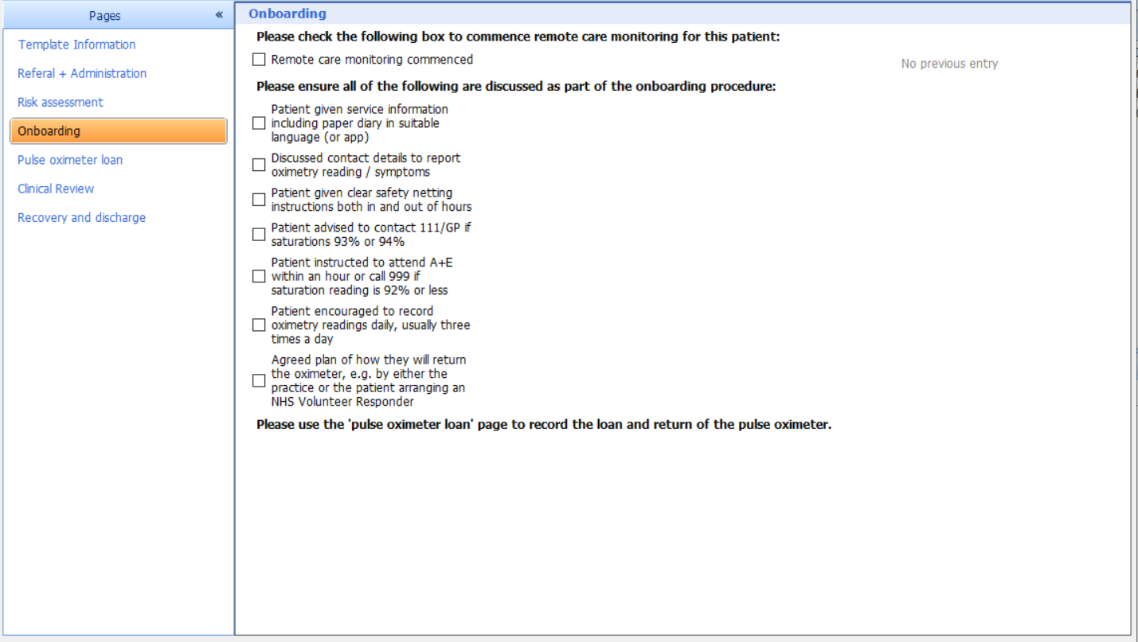
Templates
S1 users can access the template here
EMIS Web users access is from the Ardens Portal which can be accessed here

Slide 23
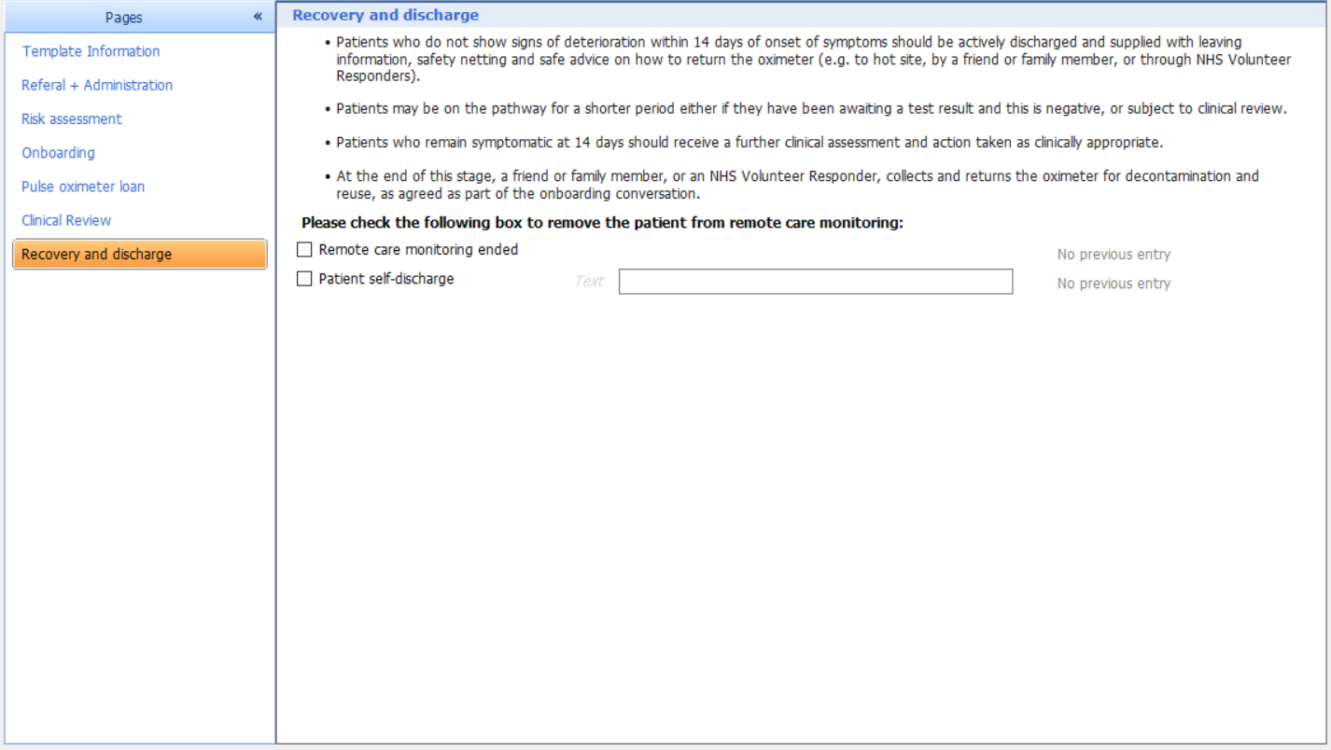
Templates
S1 users can access the template here
EMIS Web users access is from the Ardens Portal which can be accessed here

Slide 24
Ending – return and decontamination

Slide 25
Potential future developments
Timely list of covid positive patients to consider for oximetry@home
Hospital-led discharge virtual wards

Slide 26
Questions and contacts
Link to all local materials
www.northyorkshireccg.nhs.uk/home/clinical-portal/a-z-useful-clinical-%20information/oximetryhome/
Link to national webinar with clinical rationale
www.ahsnnetwork.com/covid-oximetry
Ordering more oximeters
nyccg.covid19@nhs.net
Dr Bruce Willoughby brucewilloughby@nhs.net (Clinical)
Sam Haward samhaward@nhs.net (Operational)
Julie McGregor julie.mcgregor1@nhs.net (Care homes)

