Slide 1
BP@home - Wed 9 June 2021
The presentation will start shortly…..
Meeting etiquette
Please put yourself on mute
Allow the presenters to go through their talk
Do make use of the Meeting Chat to make comments and ask questions – these will be picked up either at the end of the webinar or in the ‘FAQ’ document
Follow up
We will be recording the event – and sharing the presentation afterwards
Do email us for further information if you have subsequent comments (email addresses at end of presentation)
If there are any further updates they will sent through the GP bulletin

Slide 2
BP@home
GP webinar Wednesday 9th June 2021 1.15-2pm
Dr Bruce Willoughby
Jane Goult

Slide 3
Objectives
By the end of the session you will :
Understand the background to BP@home
Understand the local pathway and resources available
Be confident to set up and use BP@home
Know how to easily record the right minimum data for evaluation

Slide 4
Background: CVD post covid
Impact of remote consulting/QoF freeze/NHS Health Checks
Targeted CVD prevention initiatives have the greatest impact on reducing health inequalities
Highly effective at reducing stroke, myocardial infarction (MI) and other adverse cardiovascular events
Hypertension is one area to focus on where General Practice can make a huge impact

Slide 5
Link between covid and CVD

Slide 6
Improving control
73.2% of all patients are treated to target
6.7% having a Personalised Care Approach (PCA) code
If we were to reach the ambition that 80% of people with hypertension are treated to target, there are an estimated 4940 additional patients to optimise
equivalent to an additional 11 patients per 1000 practice population

Slide 7
Background
BP@home is a programme to improve BP control in people with hypertension through home monitoring by:-
identifying who is at greatest risk from their hypertension
recruiting patients to either buy their own BP monitor, or if unable to, supplying a free BP monitor, and providing resources for guided self-monitoring
monitoring their average home BP using a structured process
The use of self and telemonitoring of blood pressure is supported by evidence as it is:
cost-effective,
saves GP time by shifting care from GPs to other members of the multidisciplinary team,
produces a clinically significant reduction in BP compared to usual care,
and over five years reduces the incidence of clinical events such as death, heart attack or stroke
1300 BP machines across North Yorkshire CCG
Trailblazer site for NHS England and NHSx

Slide 8
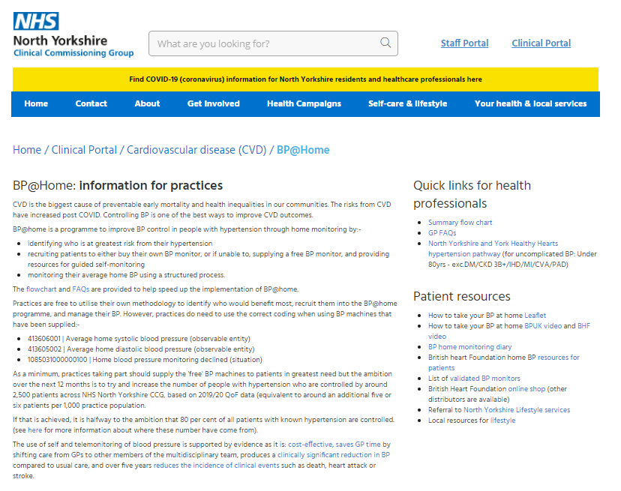
NYCCG website
https://www.northyorkshireccg.nhs.uk/clinical-portal/cardiovascular-disease/bphome/

Slide 9
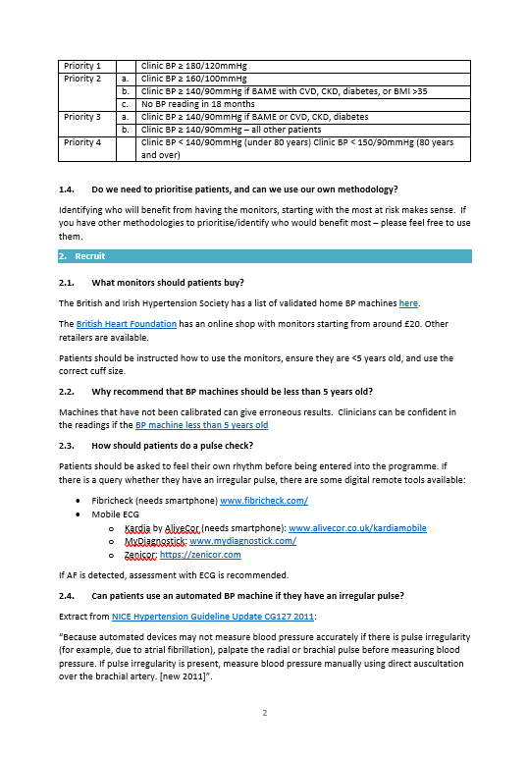
GP FAQs

Slide 10
BP@home flowchart
Identify
Recruit
Manage
Identify patients who have hypertension AND who are not controlled
Work down the list of prioritised patients
Initial monitoring of BP over
4 days with ideally 2 measurements, twice a day – but be pragmatic
Do they have an irreg pulse? Or known AF?
Y
Y
N
?AF: assess remotely (eg Fibricheck or mobile ECG device) or F2F pulse/ ECG
Home monitoring not suitable if AF. Clinic BP.
Y
Code Average Home BP
413606001 Av home syst BP
413605002 Av home diast BP
N
Prioritise patients based on BP control and covid vulnerability (eg BAME, comorbidities, obesity)
eg UCL searches
Has the patient their own monitor?
Titrate anti-hypertensives as per guidance
Y
N
Is the monitor <5 yrs old and approved?
Could they buy their own £20 monitor?
N
N
Supply monitor
Monthly check-in with 4 day average until BP controlled. Code average BP each time
Y
Y
Provide training and resources to self monitor BP eg leaflet, video, patient diary, accuRx BP monitoring Florey
6-monthly check-in once BP controlled.
Code average BP each time

Slide 11
BP@home flowchart
Identify
Identify patients who have hypertension AND who are not controlled
Prioritise patients based on BP control and covid vulnerability (eg BAME, comorbidities, obesity)
eg UCL searches

Slide 12
BP@home flowchart
Identify
https://uclpartners.com/proactive-care/search-and-risk-stratification-tools/
Identify patients who have hypertension AND who are not controlled
Priority 1 |  | Clinic BP ≥ 180/120mmHg
Priority 2 | a. | Clinic BP ≥ 160/100mmHg
 | b. | Clinic BP ≥ 140/90mmHg if BAME with CVD, CKD, diabetes, or BMI >35
 | c. | No BP reading in 18 months
Priority 3 | a. | Clinic BP ≥ 140/90mmHg if BAME or CVD, CKD, diabetes
 | b. | Clinic BP ≥ 140/90mmHg – all other patients
Priority 4 |  | Clinic BP < 140/90mmHg (under 80 years) Clinic BP < 150/90mmHg (80 years and over)
Prioritise patients based on BP control and covid vulnerability (eg BAME, comorbidities, obesity)
eg UCL searches

Slide 13
BP@home flowchart
Recruit
Work down the list of prioritised patients
Do they have an irreg pulse? Or known AF?
Y
Y
N
?AF: assess remotely (eg Fibricheck or mobile ECG device) or F2F pulse/ ECG
Home monitoring not suitable if AF. Clinic BP.
Y
N
Has the patient their own monitor?
Y
N
Is the monitor <5 yrs old and approved?
Could they buy their own £20 monitor?
N
N
Supply monitor
Y
Y
Provide training and resources to self monitor BP eg leaflet, video, patient diary, accuRx BP monitoring Florey

Slide 14
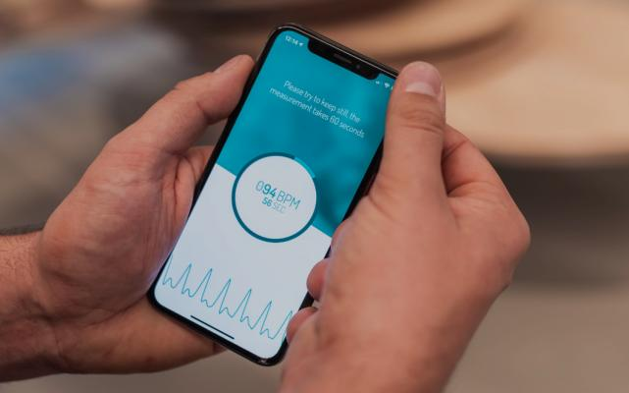
BP@home flowchart
Recruit
Work down the list of prioritised patients
Do they have an irreg pulse? Or known AF?
Y
Y
N
?AF: assess remotely (eg Fibricheck or mobile ECG device) or F2F pulse/ ECG
Home monitoring not suitable if AF. Clinic BP.
Y
N
Has the patient their own monitor?
Y
N
Is the monitor <5 yrs old and approved?
Could they buy their own £20 monitor?
N
N
Supply monitor
Y
Y
Provide training and resources to self monitor BP eg leaflet, video, patient diary, accuRx BP monitoring Florey

Slide 15
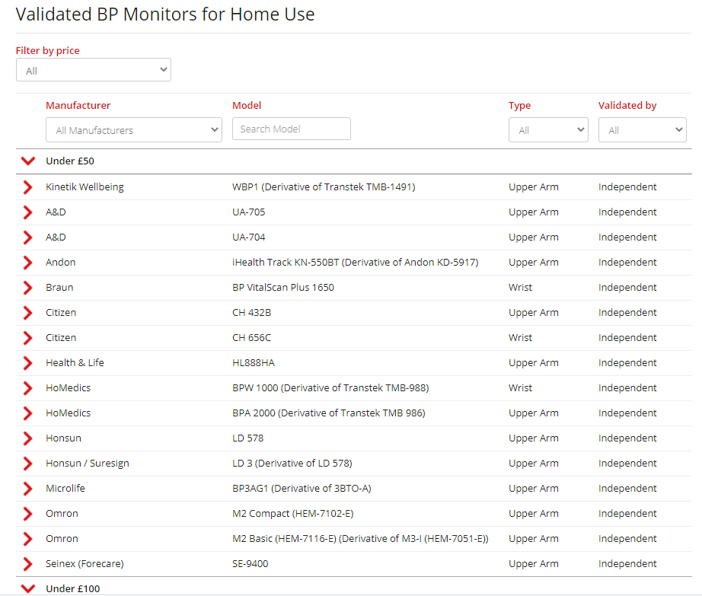
BP@home flowchart
Recruit
Work down the list of prioritised patients
Do they have an irreg pulse? Or known AF?
Y
Y
N
?AF: assess remotely (eg Fibricheck or mobile ECG device) or F2F pulse/ ECG
Home monitoring not suitable if AF. Clinic BP.
Y
N
Has the patient their own monitor?
Y
N
Is the monitor <5 yrs old and approved?
Could they buy their own £20 monitor?
N
N
Supply monitor
Y
Y
Provide training and resources to self monitor BP eg leaflet, video, patient diary, accuRx BP monitoring Florey

Slide 16
BP@home flowchart
Recruit
Measuring cuff sizes:
Advice from the BHF
Take a piece of string and wrap around your upper arm at the midpoint between your shoulder and elbow.
Measure the length of the piece of string.
Choose the correct cuff size as per the table
Work down the list of prioritised patients
Do they have an irreg pulse? Or known AF?
Y
Y
N
?AF: assess remotely (eg Fibricheck or mobile ECG device) or F2F pulse/ ECG
Home monitoring not suitable if AF. Clinic BP.
Y
N
Cuff (Code) | Arm circumference range
Small (S) | 17-22cm
Medium (M) | 22-32cm [Standard/Normal cuff]
Large (L) | 32-42cm
Wide-range (W) | 22-42cm [i.e. ~ M+L]
Extra-large (XL) | 42-50cm [Uncertain availability]
Has the patient their own monitor?
Y
N
Is the monitor <5 yrs old and approved?
Could they buy their own £20 monitor?
N
N
Supply monitor
Y
Y
Provide training and resources to self monitor BP eg leaflet, video, patient diary, accuRx BP monitoring Florey

Slide 17
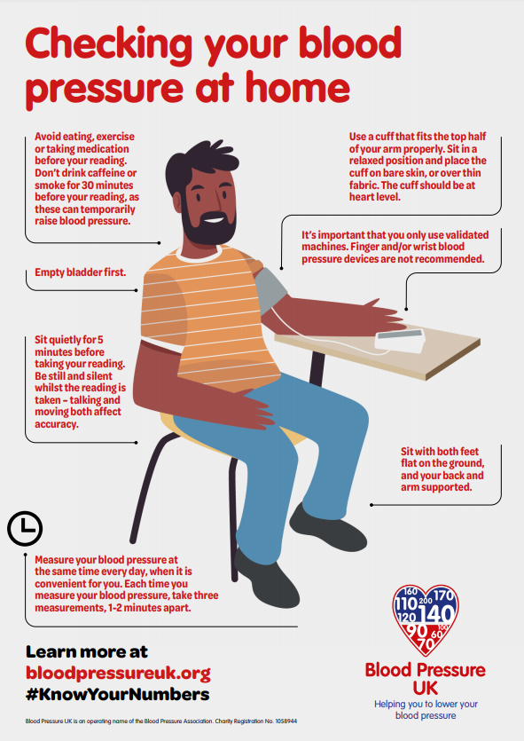

Slide 18
AccuRx BP monitoring Florey Plus
https://support.accurx.com/en/articles/4747405-florey-snomed-codes-and-questions-for-the-blood-pressure-questionnaire-7d-home-monitoring

Slide 20
BP@home flowchart
Manage
Initial monitoring of BP over
4 days with ideally 2 measurements, twice a day – but be pragmatic
Code Average Home BP
413606001 Av home syst BP
413605002 Av home diast BP
Titrate anti-hypertensives as per guidance
Monthly check-in with 4 day average until BP controlled. Code average BP each time
6-monthly check-in once BP controlled.
Code average BP each time

Slide 21
BP@home flowchart
Manage
Initial monitoring of BP over
4 days with ideally 2 measurements, twice a day – but be pragmatic
Clinic BP reading | Equivalent Home BP
BP = 180/120mmHg | BP = 170/115mmHg
BP = 160/100mmHg | BP = 150/95mmHg
BP = 150/90mmHg | BP = 145/85mmHg
BP = 140/90mmHg | BP = 135/85mmHg
Code Average Home BP
413606001 Av home syst BP
413605002 Av home diast BP
Titrate anti-hypertensives as per guidance
Monthly check-in with 4 day average until BP controlled. Code average BP each time
6-monthly check-in once BP controlled.
Code average BP each time

Slide 22
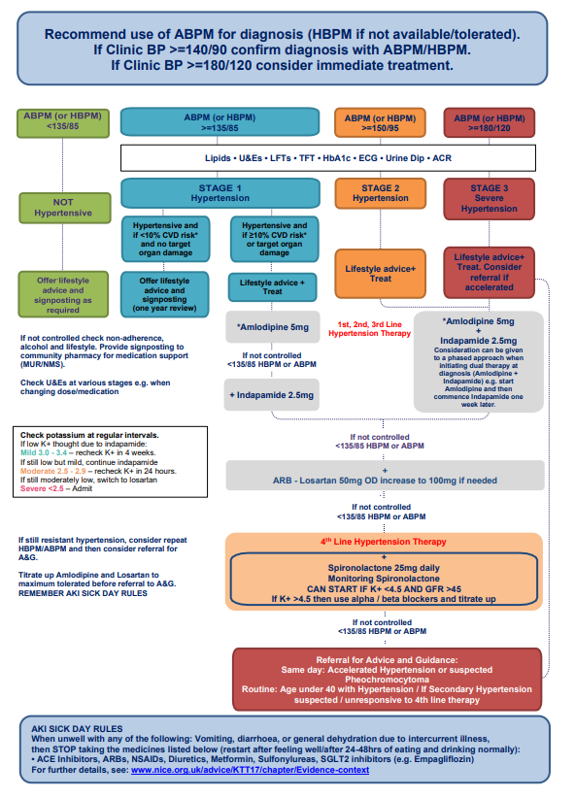
BP@home flowchart
Manage
Initial monitoring of BP over
4 days with ideally 2 measurements, twice a day – but be pragmatic
Code Average Home BP
413606001 Av home syst BP
413605002 Av home diast BP
Titrate anti-hypertensives as per guidance
Monthly check-in with 4 day average until BP controlled. Code average BP each time
6-monthly check-in once BP controlled.
Code average BP each time
https://www.northyorkshireccg.nhs.uk/wp-content/uploads/2021/05/Healthy_Hearts_Hypertension_guidance_updated.01.pdf

Slide 23
Evaluation
Coding = automatic extraction
413606001 | Average home systolic blood pressure (observable entity)
413605002 | Average home diastolic blood pressure (observable entity)
1085031000000100 | Home blood pressure monitoring declined (situation)
Use of AccuRx = automatic extraction
Monthly web form with 10 simple questions eg:
Which searches?
How many BP machines given out?
Loan or give or mixture?
Which digital platform?

Slide 24
Summary
Identify patients most at risk from uncontrolled hypertension
Recruit high risk patients to the programme to either use their own monitor or give them one
Manage their BP through home monitoring using digital pathways or diary
Record the correct codes when using the remote monitor readings

Slide 25
Questions and links
Contact: brucewilloughby@nhs.net
BP@home resources:
https://www.northyorkshireccg.nhs.uk/clinical-portal/cardiovascular-disease/bphome/
Healthy Hearts Hypertension pathway
https://www.northyorkshireccg.nhs.uk/wp-content/uploads/2021/05/Healthy_Hearts_Hypertension_guidance_updated.01.pdf
CVD prevention data
https://tinyurl.com/35fz7929
PCCS pack
https://tinyurl.com/mzf9tty5
UCL Partners pack
https://uclpartners.com/proactive-care/cvd-resources/

